Slide 1
‘Cyclistic’ Bike riding company data analysis
By
SAFAWAT AL NASER

Slide 2
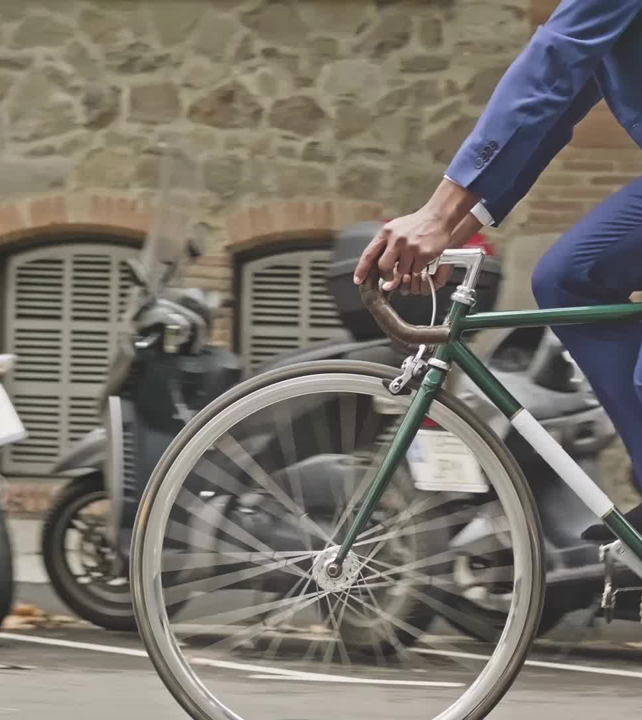
Overview Of The Company
In 2016, Cyclistic launched a successful bike-share offering. Since then, the program has grown to a fleet of 5,824 bicycles that are geo tracked and locked into a network of 692 stations across Chicago. The bikes can be unlocked from one station and returned to any other station in the system anytime. Until now, Cyclistic’s marketing strategy relied on building general awareness and appealing to broad consumer segments. One 2 approach that helped make these things possible was the flexibility of its pricing plans: single-ride passes, full-day passes, and annual memberships. Customers who purchase single-ride or full-day passes are referred to as casual riders. Customers who purchase annual memberships are Cyclistic members.

Slide 3

SCENARIO
You are a junior data analyst working in the marketing analyst team at Cyclistic, a bike-share company in Chicago. The director of marketing believes the company’s future success depends on maximizing the number of annual memberships. Therefore, your team wants to understand how casual riders and annual members use Cyclistic bikes differently. From these insights, your team will design a new marketing strategy to convert casual riders into annual members. But first, Cyclistic executives must approve your recommendations, so they must be backed up with compelling data insights and professional data visualizations

Slide 4

Question to answer?
How do annual members and casual riders use Cyclistic bikes differently?
Where is the data from?
Whether data is credible or not?
What tools used during this analysis?

Slide 5

Tools used
R programing language for data cleaning, preparing.
Bigquery for searching the required information.
Tableau for data ViZ
Data is collected from Motivate International Inc. which is a licensed source of data so it ensures data credibility.
I used data of 2022 to see how they did withing this whole year.
Tableau link: https://public.tableau.com/views/Bikeridingcompanydataanalysis/Dashboard2?:language=en-US&:display_count=n&:origin=viz_share_link

Slide 6
DELIVERABLES:
Data from 2022.
Total column 16 AND rows 5600000.
Monthly data way available which was merged using R.
Null values available which need to take care using R or Tableau.
Need to change some data types and use calculation for calculating duration.

Slide 7
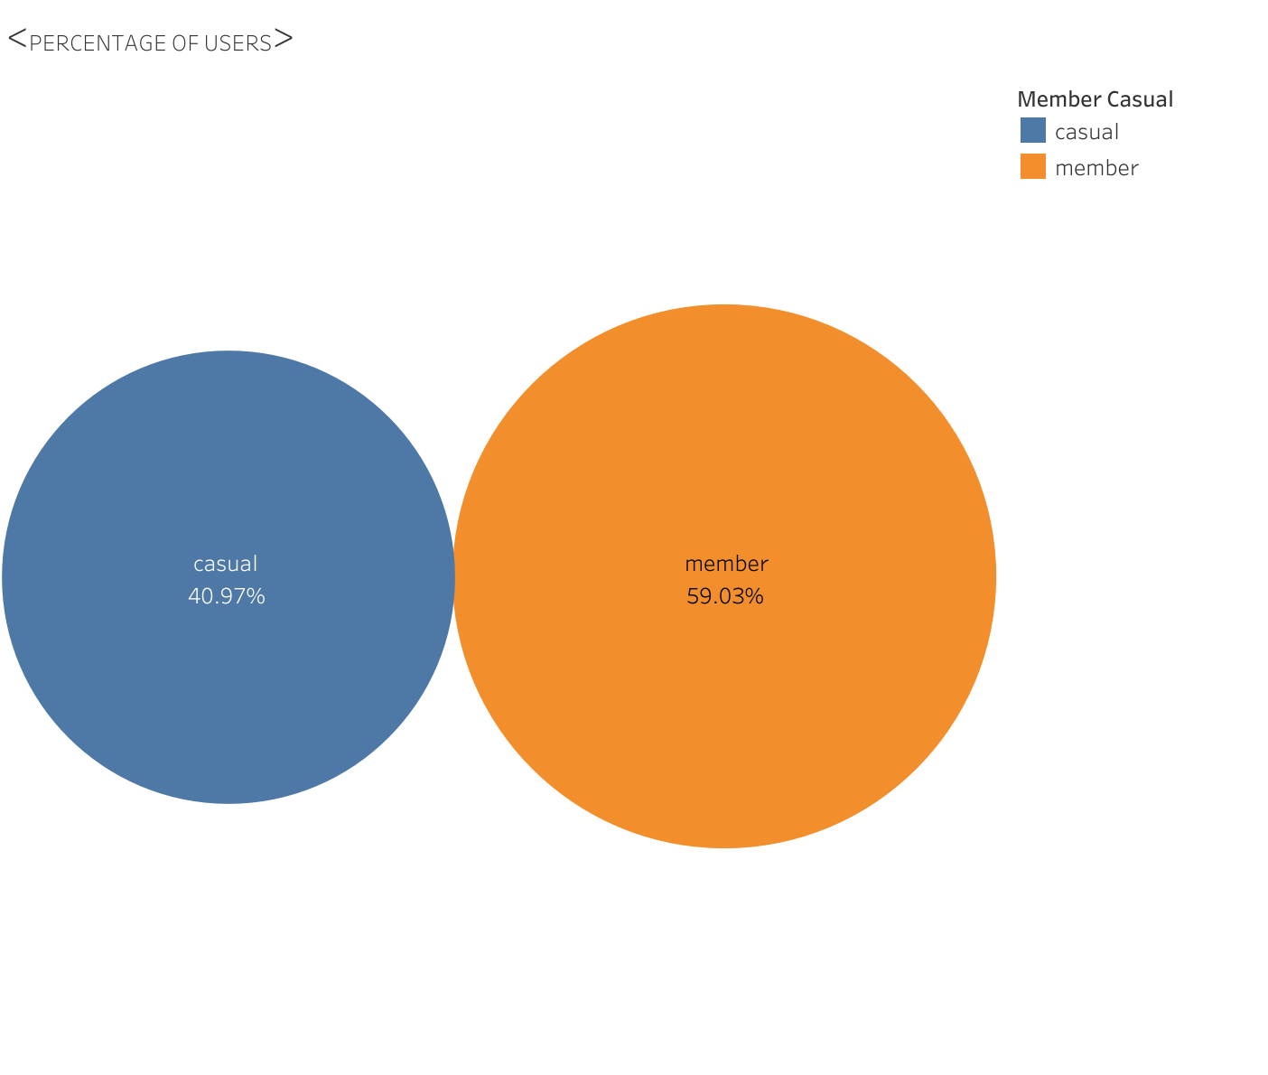
Findings From Data:
59.03% members are permanent and rest of them used bike as casual member,

Slide 8
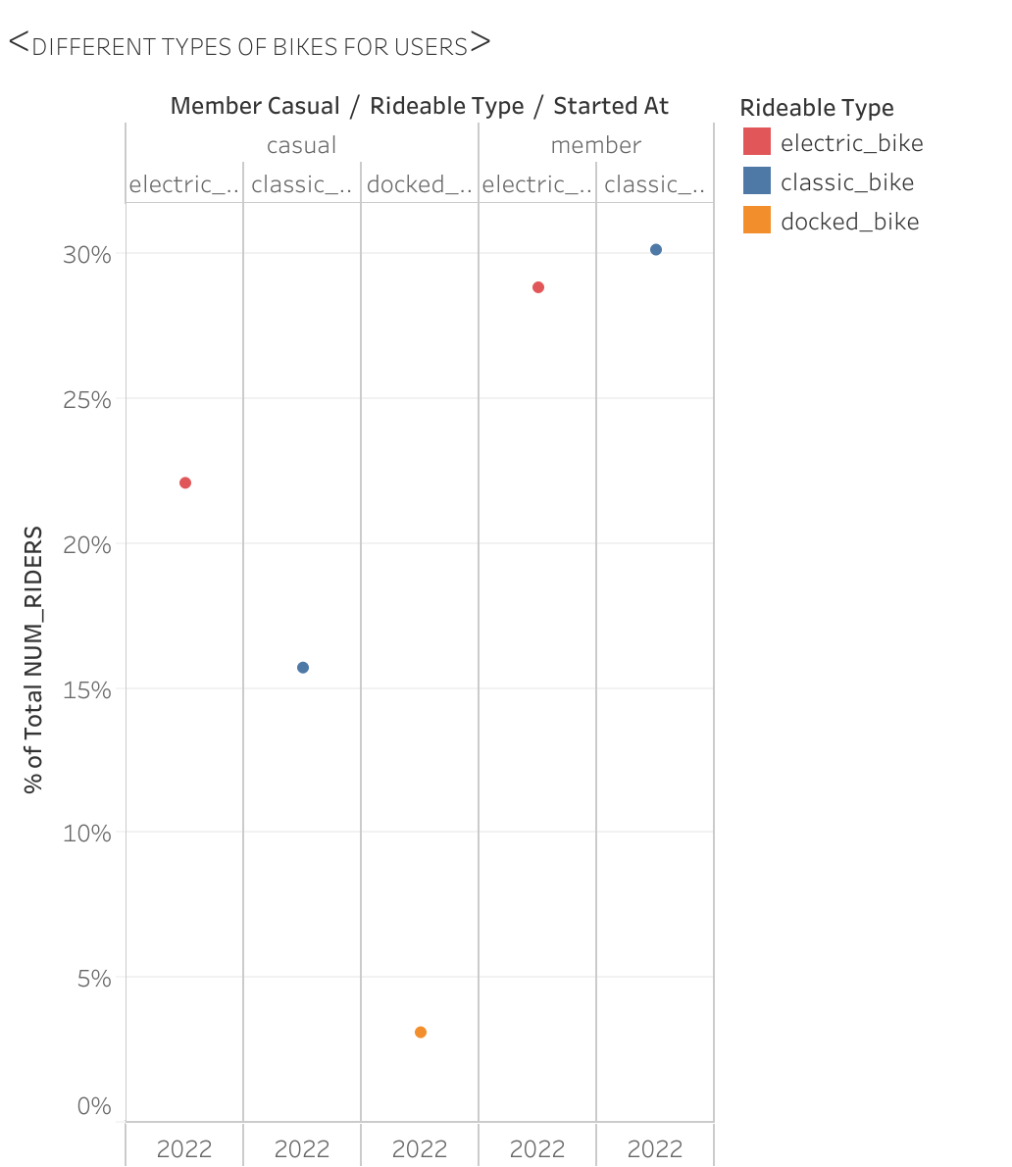
Findings Cont.
Permanent members preferred classic bike as well as electric bike almost equally (30%)
Docker bikes are only used by casual members.

Slide 9
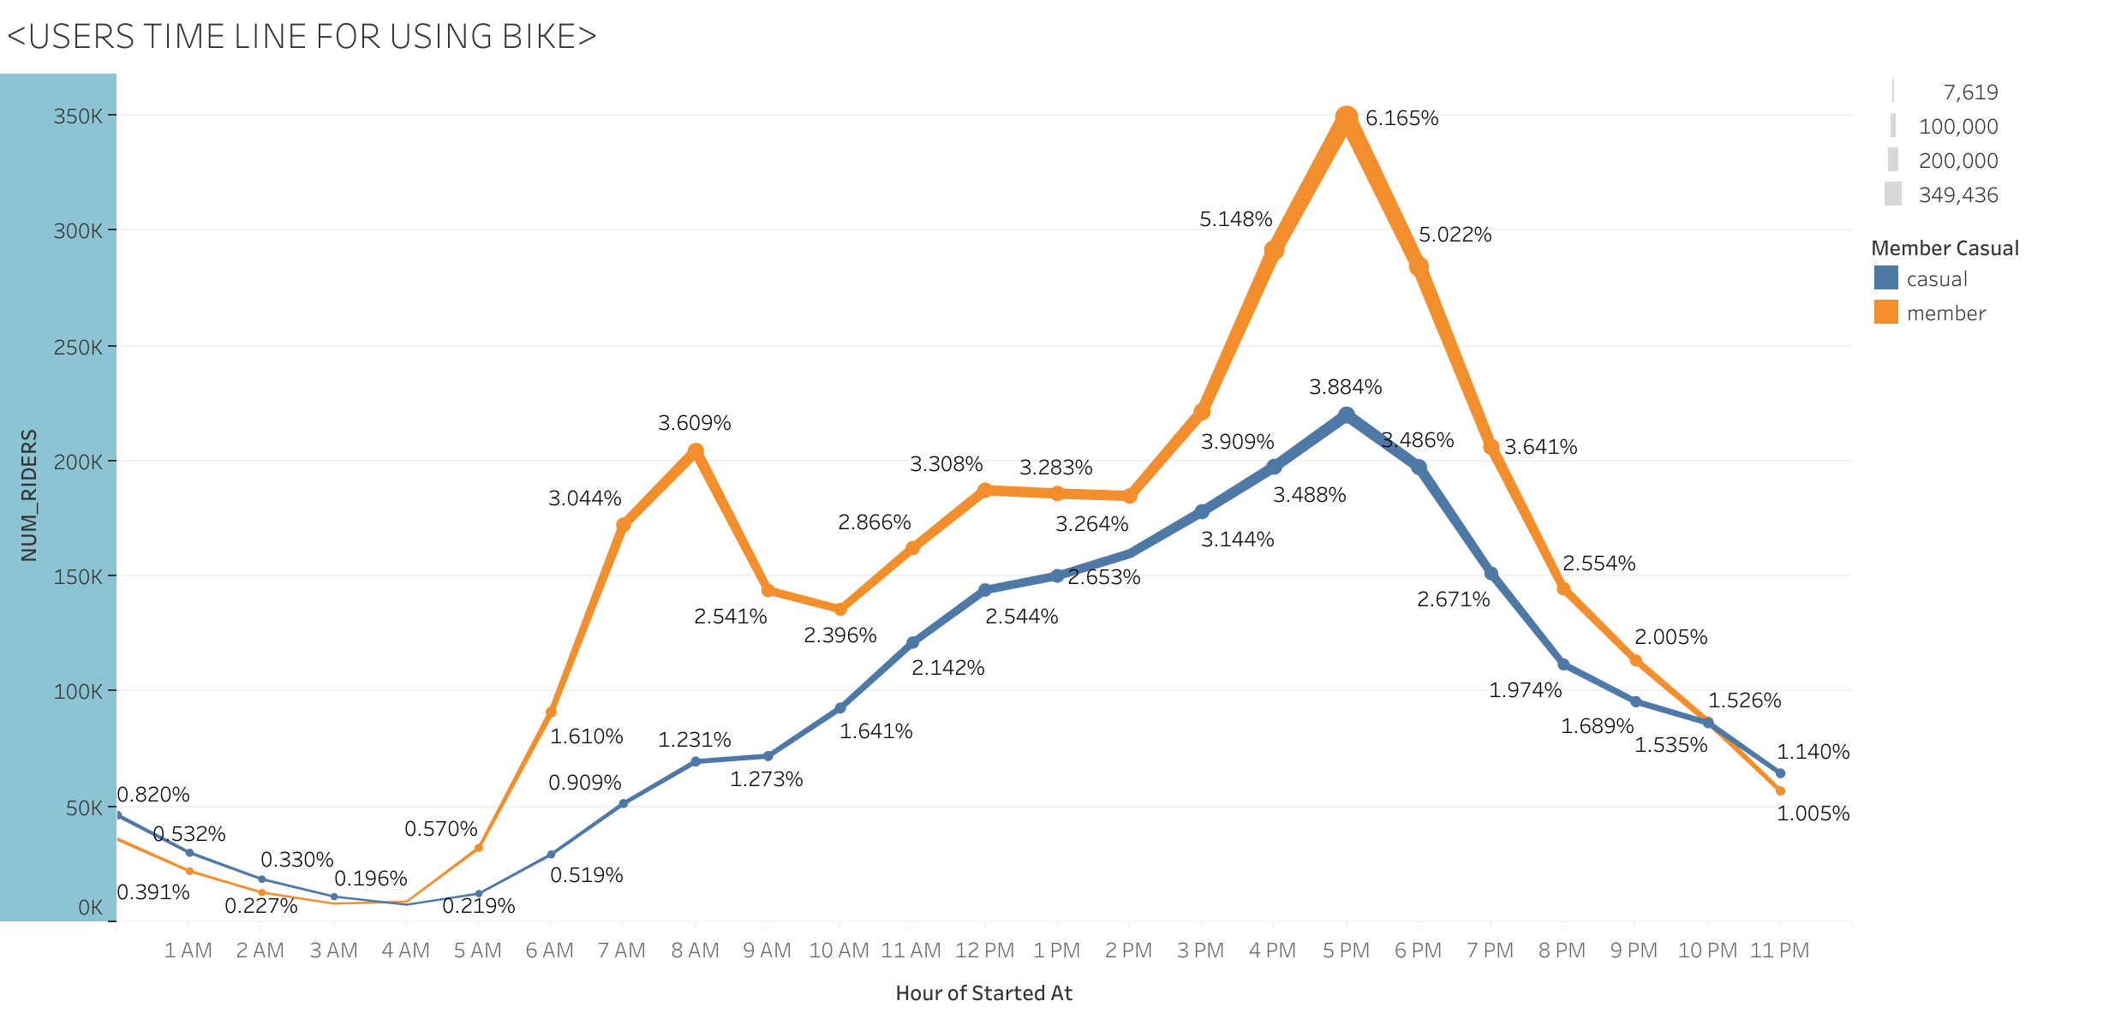
Findings Cont.
Hourly Trend of data:
Bike using rate is high between 2 pm to 6 pm.
This is due to office hour.
During Non-Office hour casual rider’s number is slightly high.

Slide 10
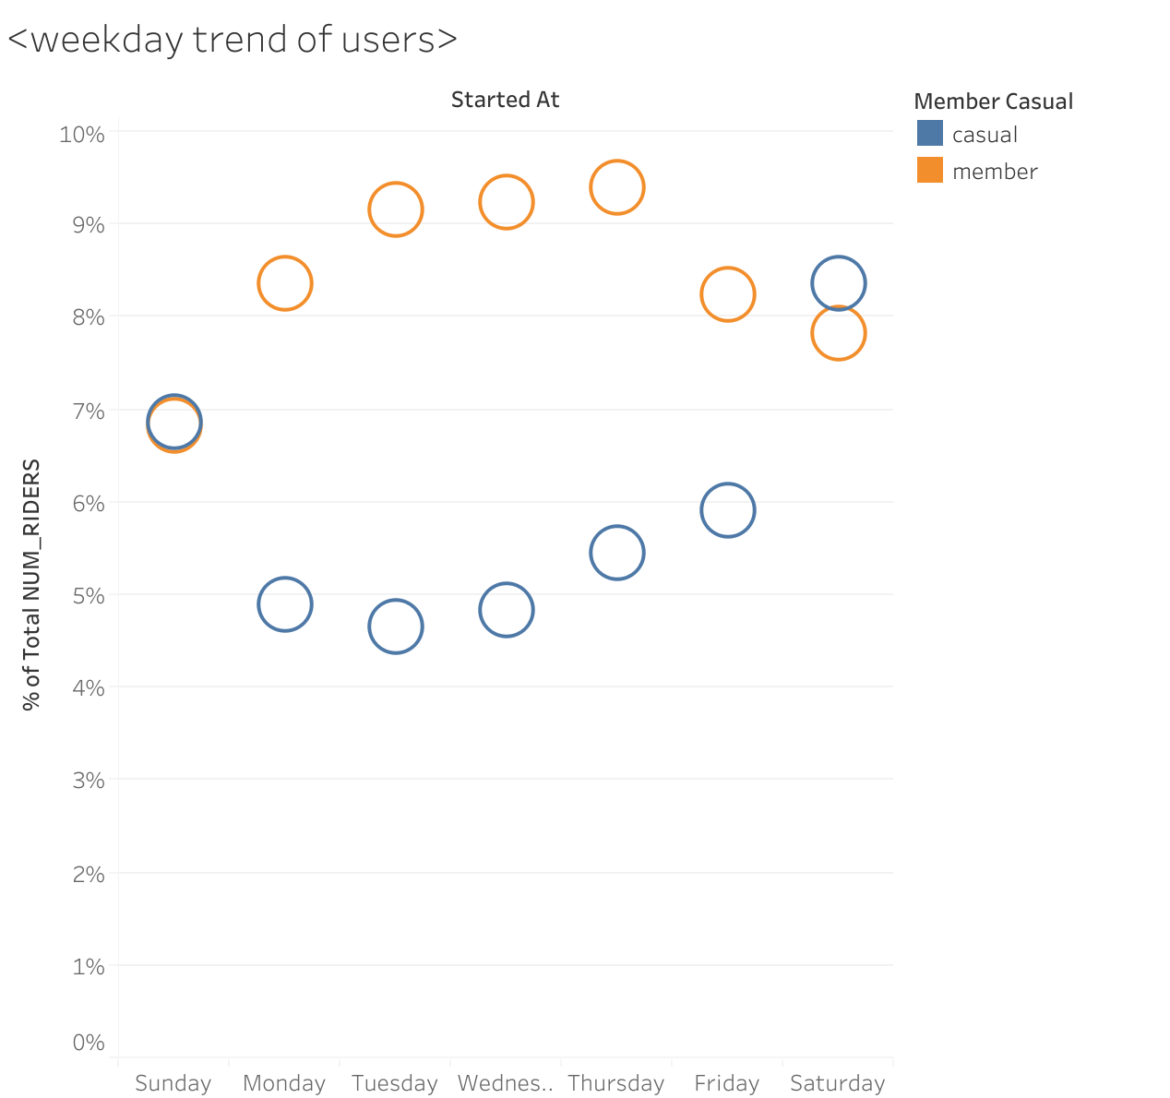
Findings Cont.
Day wise pattern of data:
During weekdays permanent members use the bike most but on Saturday and Sunday using bike by casual riders are significantly high.

Slide 11
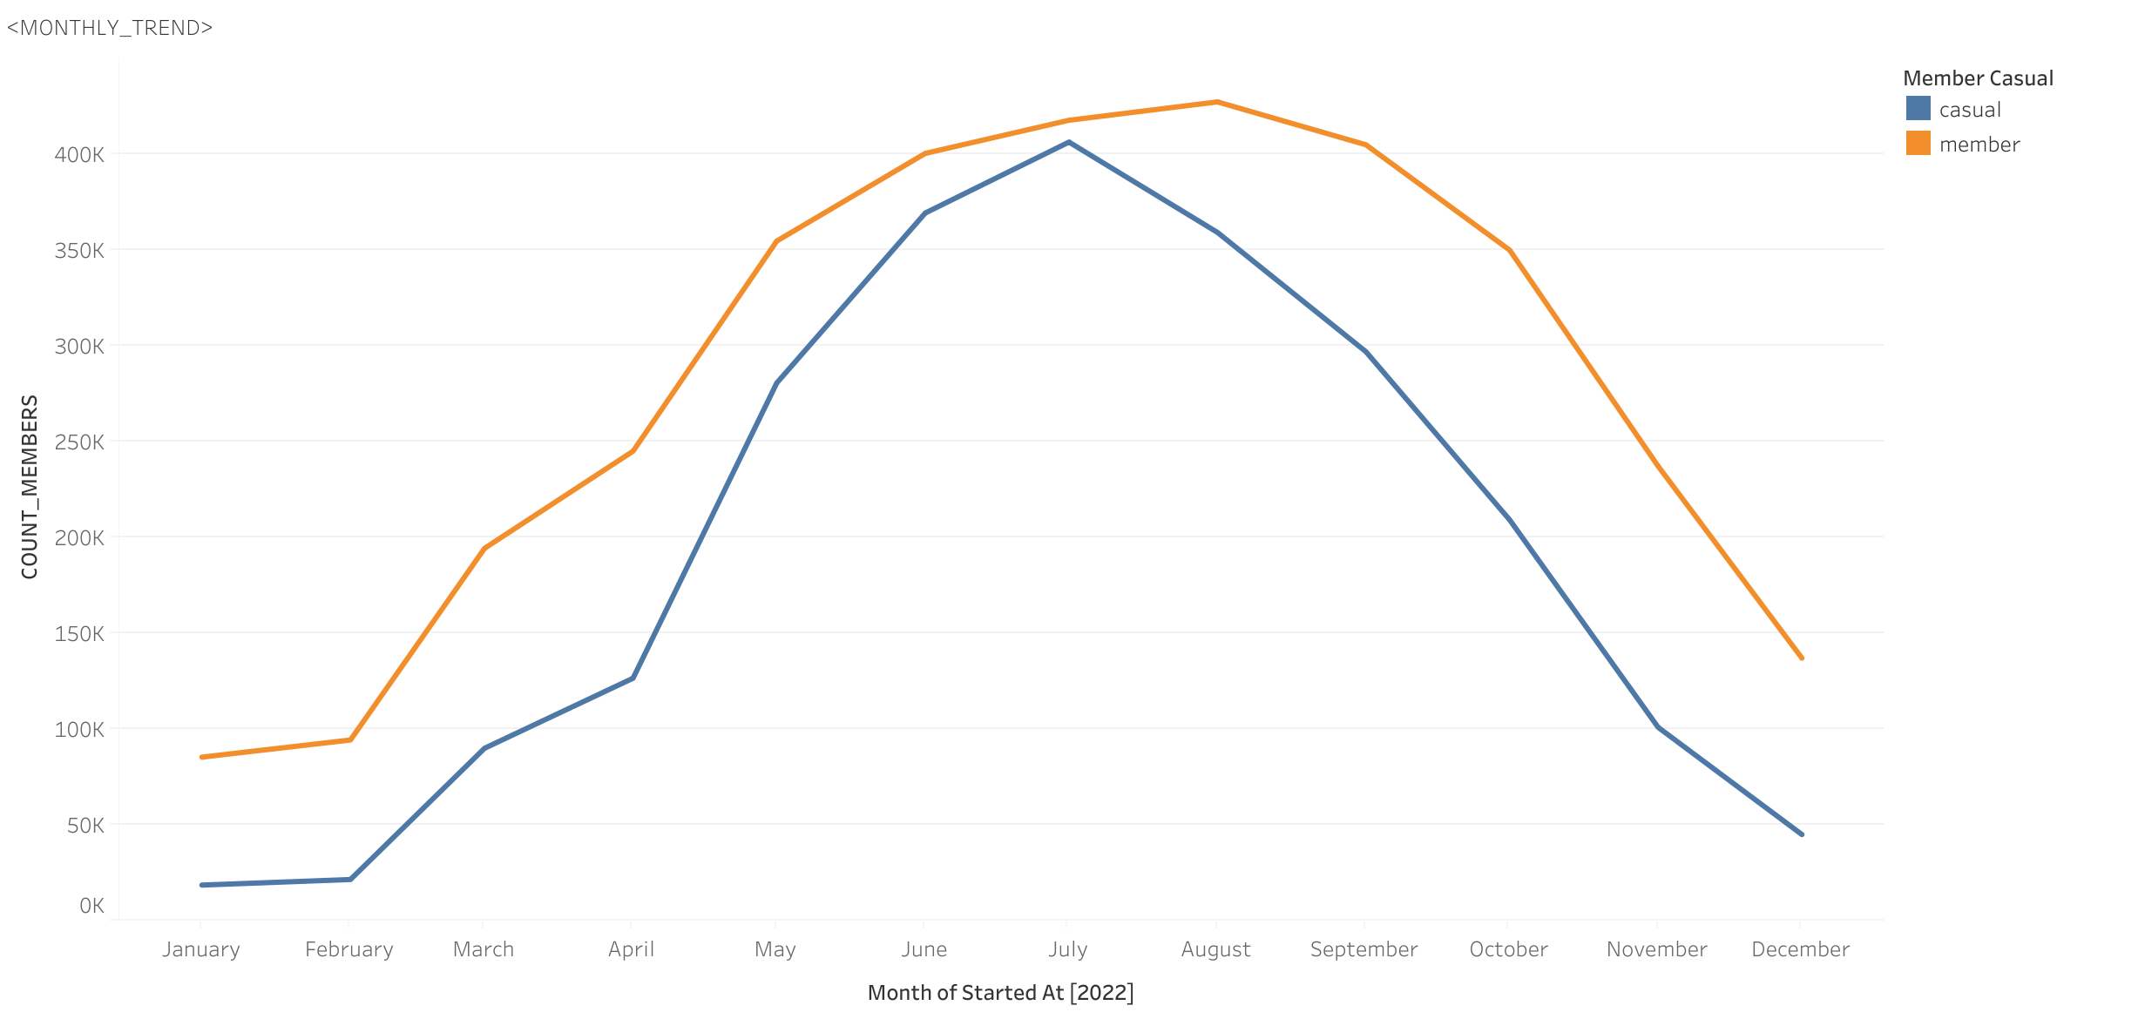
Findings Cont.
Monthly trend of data:
Highest permanent members number in July whereas casual rider’s highest number in the moth of July .
Drop of users during winter and summer.

Slide 12
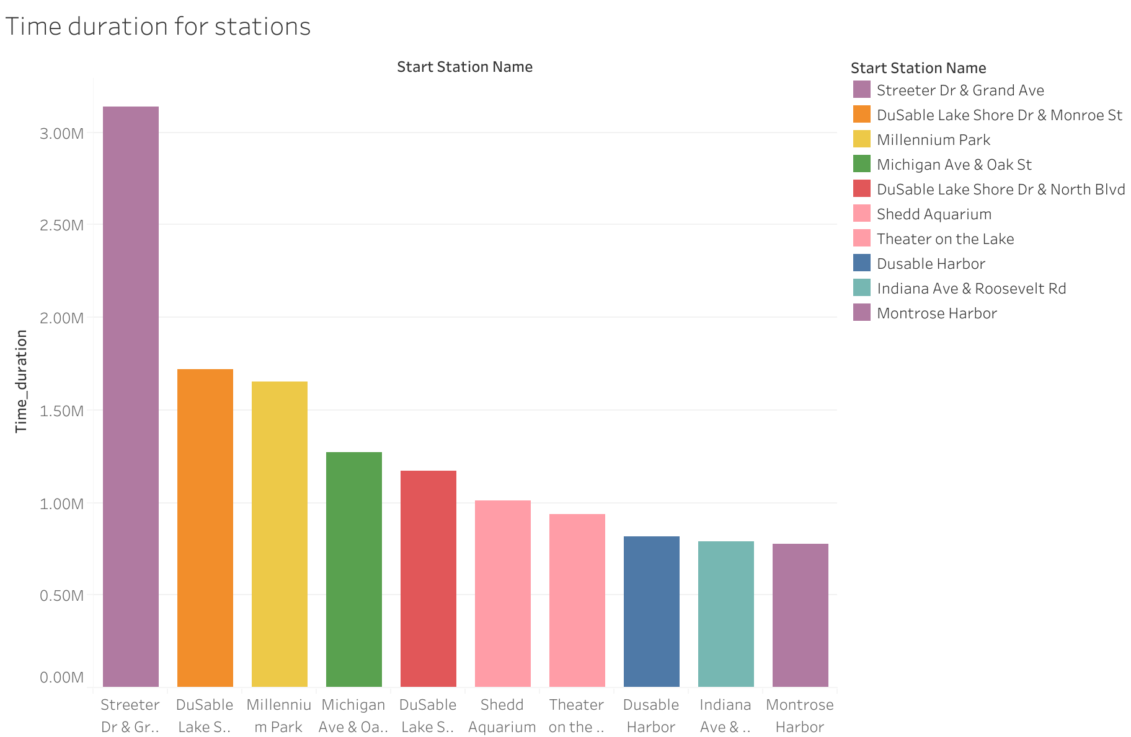
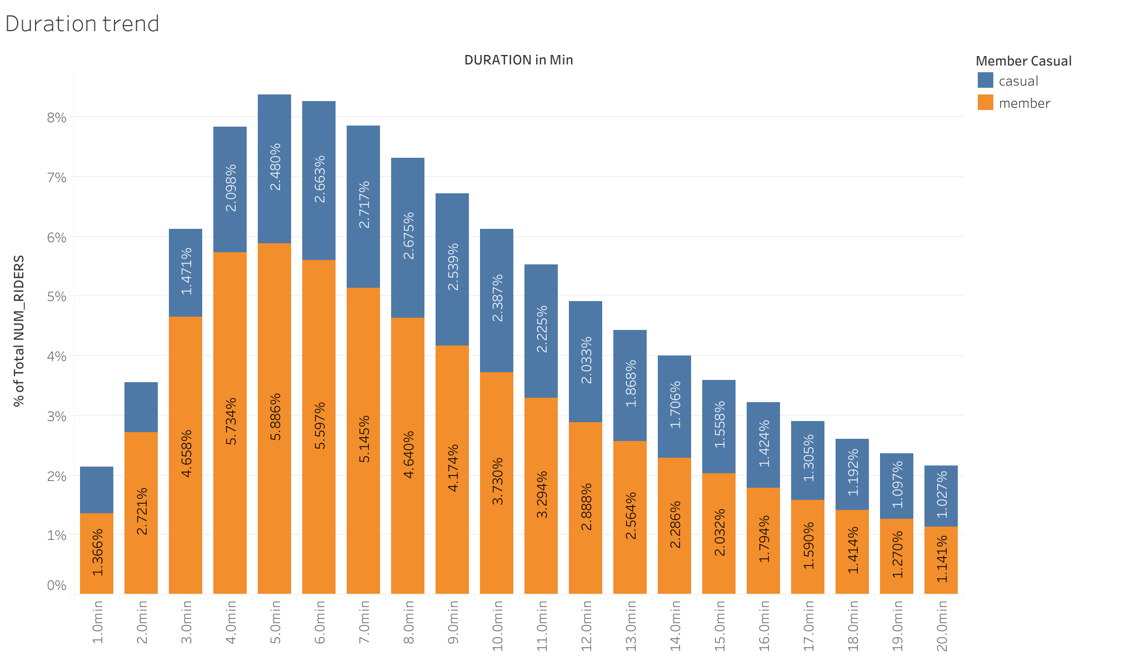
Findings Cont.
Time Duration:
Both members used the bike for the shorter time between 3 mins to 20 mins. But for the longer duration casual user member’s number is high.

Slide 13
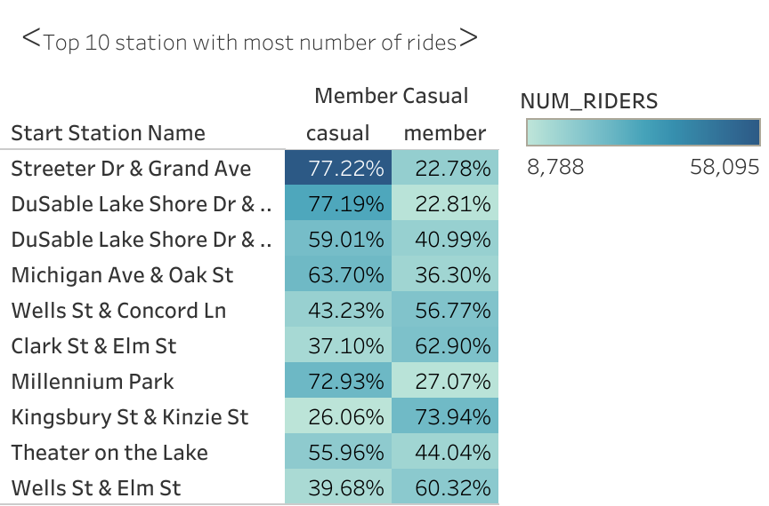
Findings Cont.
Top 10 stations for users

Slide 14
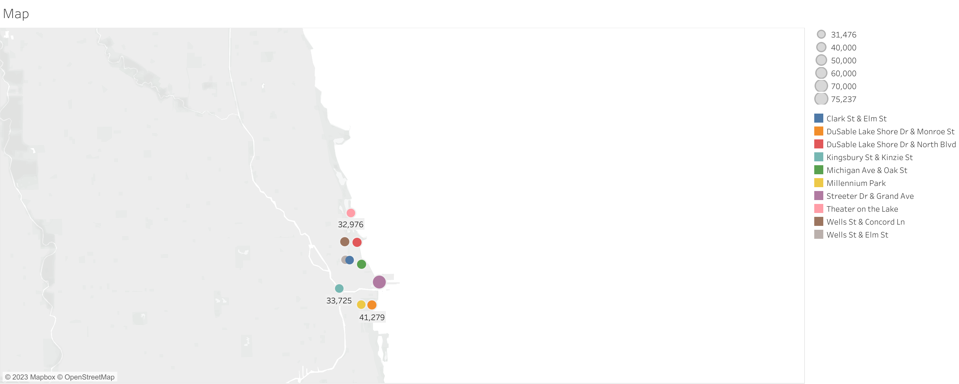
Findings Cont…..
Top 10 visited stations map

Slide 15
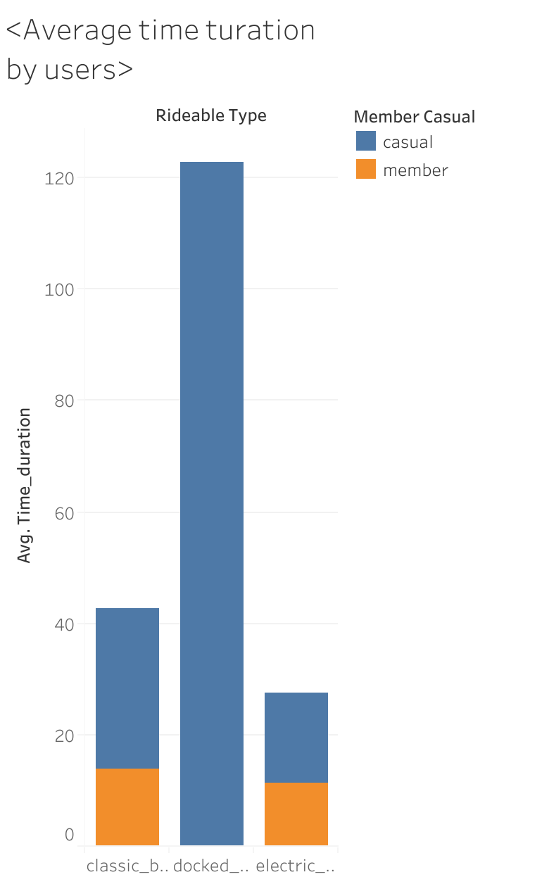
Findings Cont.
Average Time spent by users:
We can see that Docked type bike travel for the longest possible time which used by only casual members.

Slide 16

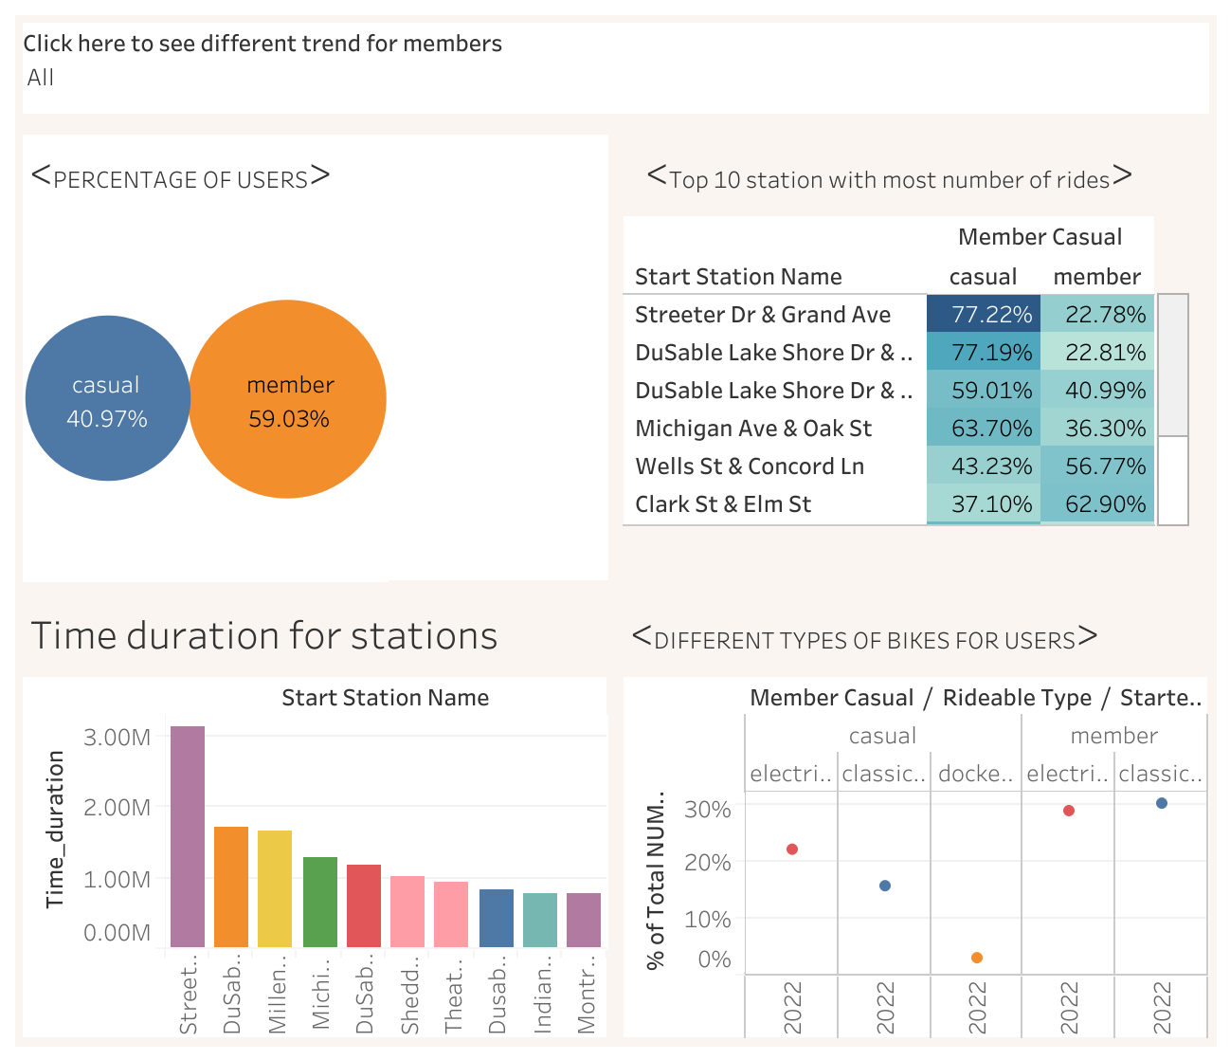
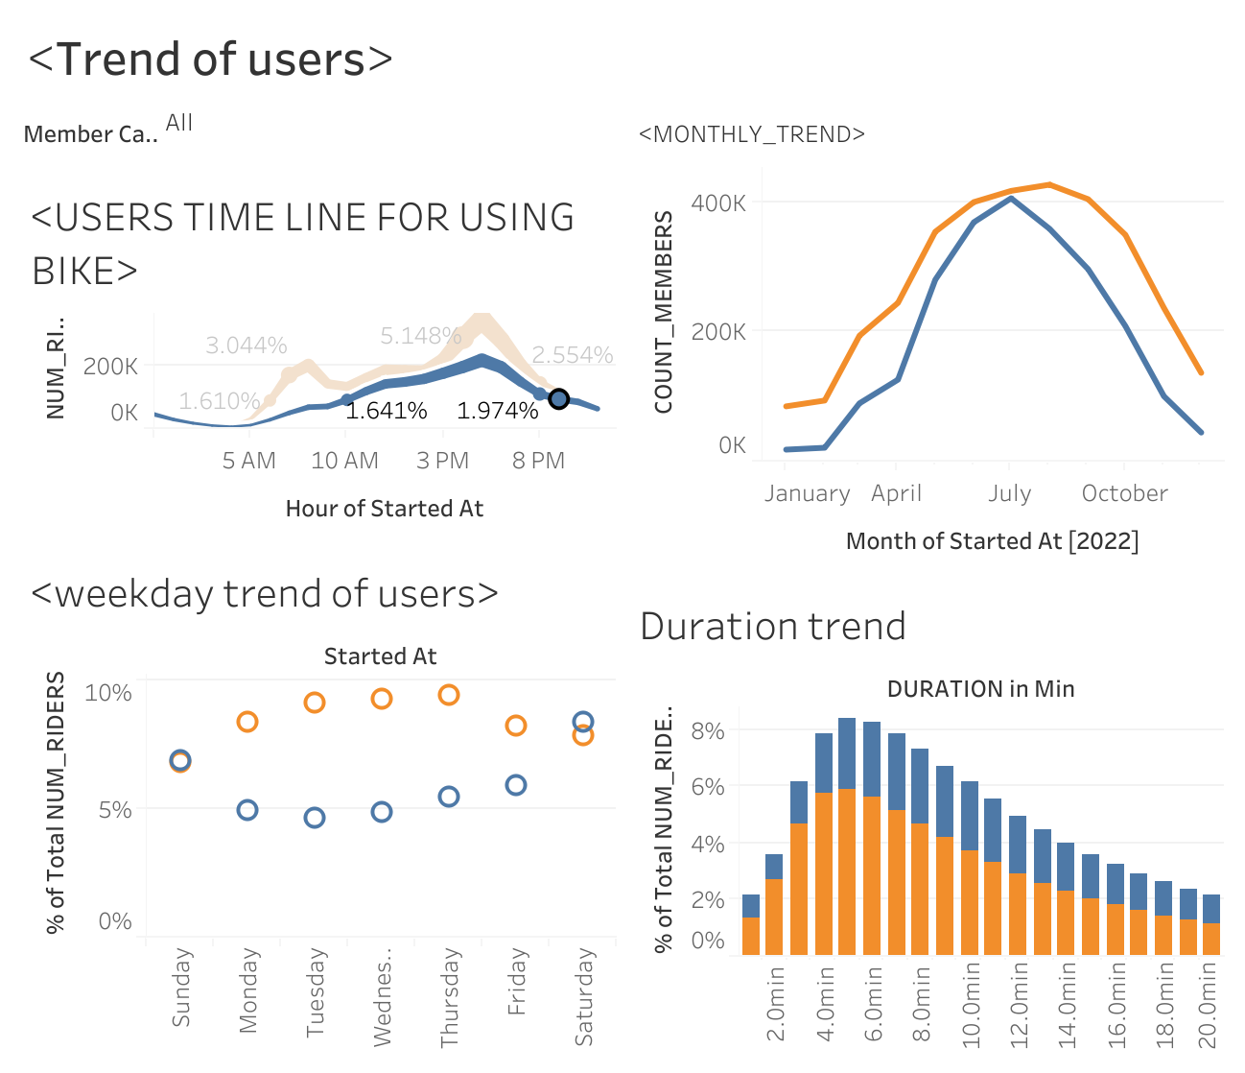
DASHBOARD

Slide 17

Total scenario of analysis.
Difference between permanent and casual members in number is only 10%. Members tend to use the Bicycle for shortest distance and for shortest time. During the weekend casual rider’s use the bicycle most.

Slide 18
RECOMMENDATIONS:
As the permanent members are most beneficial for the business need to increase the permanent members percentage. Company can offer one day free ride to casual members to become a permanent ones.
Different promotional activities and diverse pricing strategy could help to increase the permanent members.
Special discount for student will be a good strategies for the company.
As bike has physical and environmental benefits collaborating with both sector could be beneficial in business

